Slide 1
机器人与人工智能实验室 Robotics and Artificial Intelligence Laboratory
WELCOME TO

Slide 2
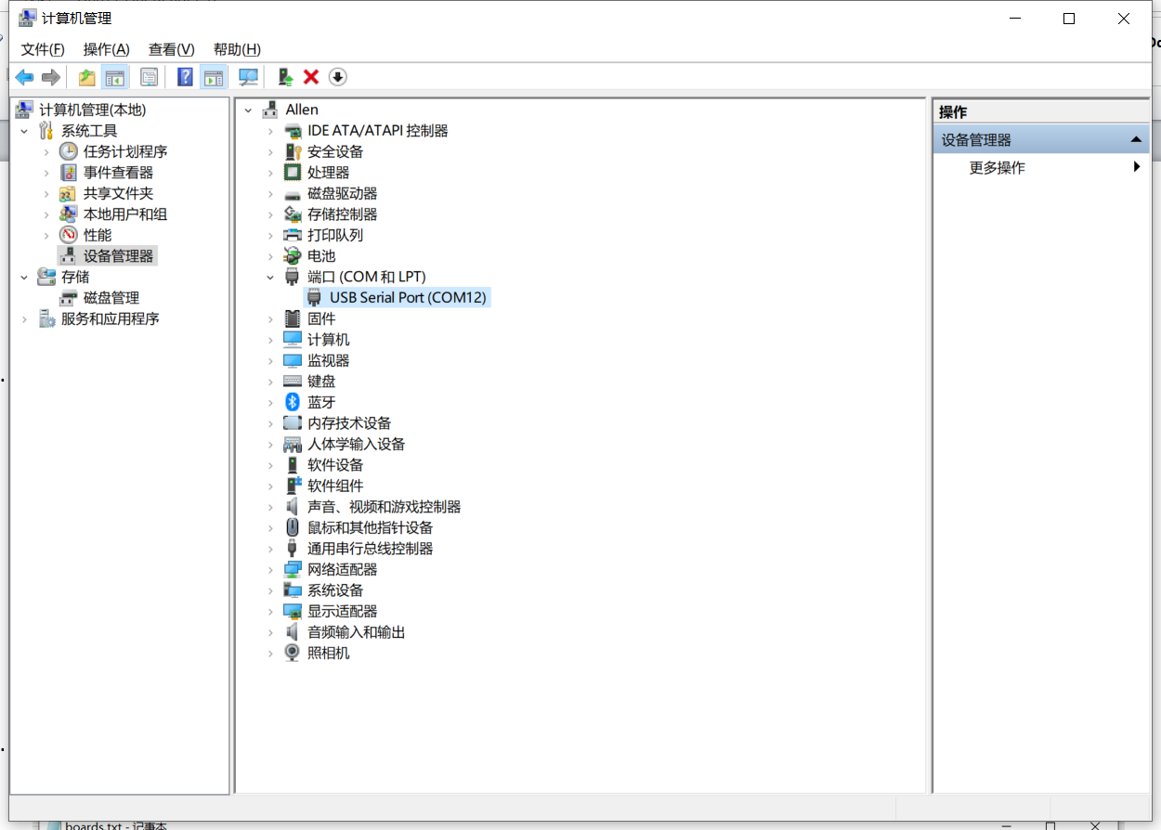
Tips for Assembling
①
1. The Drive
Check the followings:
Manage
Device Manager
Port
②
③

Slide 3
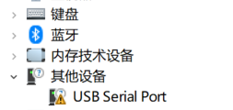
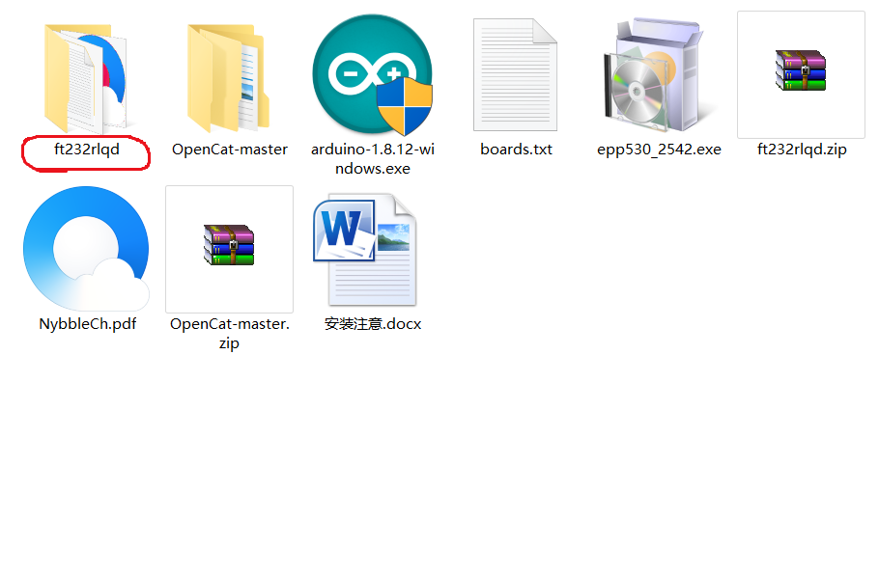
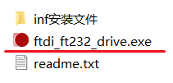
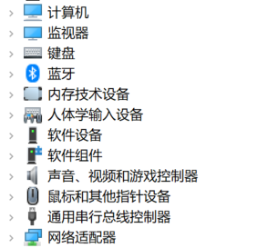
Tips for Assembling
The Drive
Just download and install the drive manually!
If you encountered this:
Or no response like:
Click

Slide 4
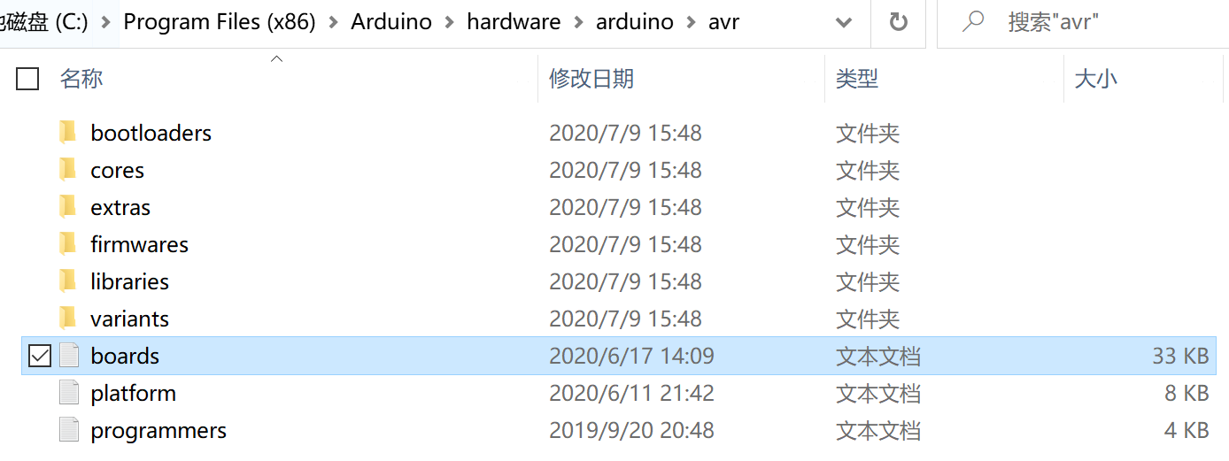
Tips for Assembling
2. The File board.txt
Replace the former file board.txt by the new one provided.
C:\Program Files (x86)\Arduino\hardware\arduino\avr

Slide 5
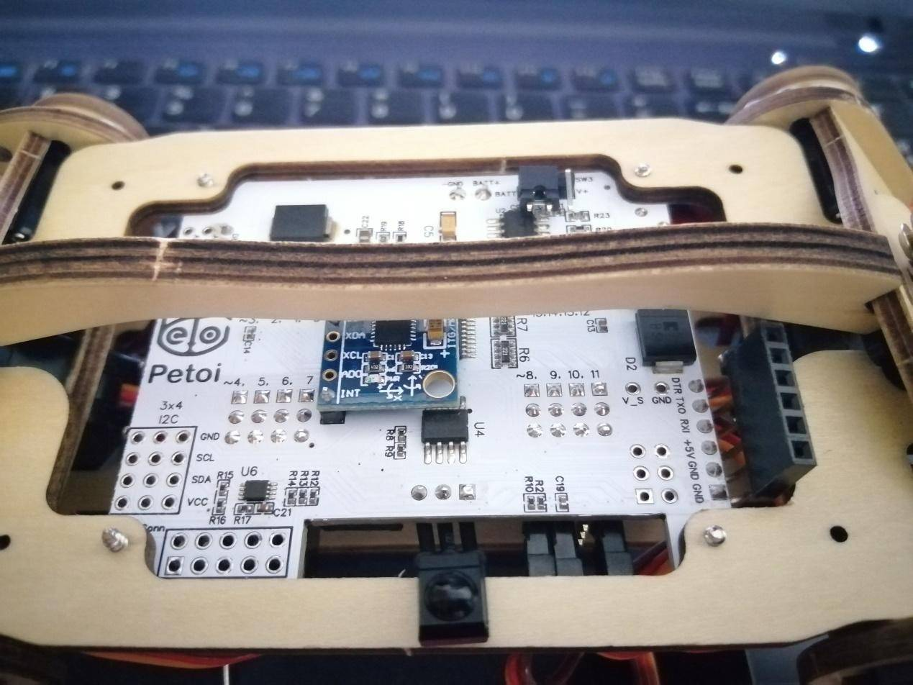
Tips for Assembling
3. The Pin
Bend the pin of the download port upward with pliers before fixing the Nyboard.

Slide 6
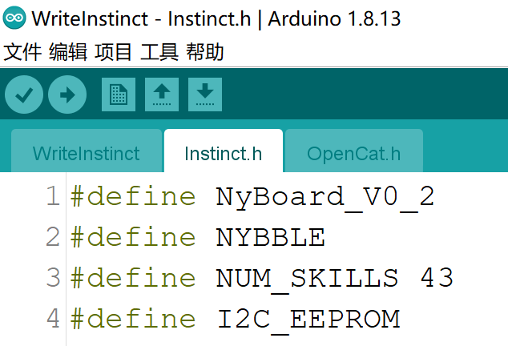
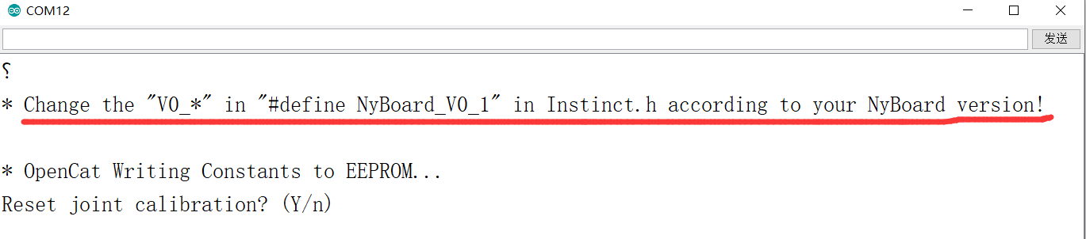
Tips for Assembling
4. The Version Number
Revise the version number of Nyboard in file instinct.h with the correct one.

Slide 7
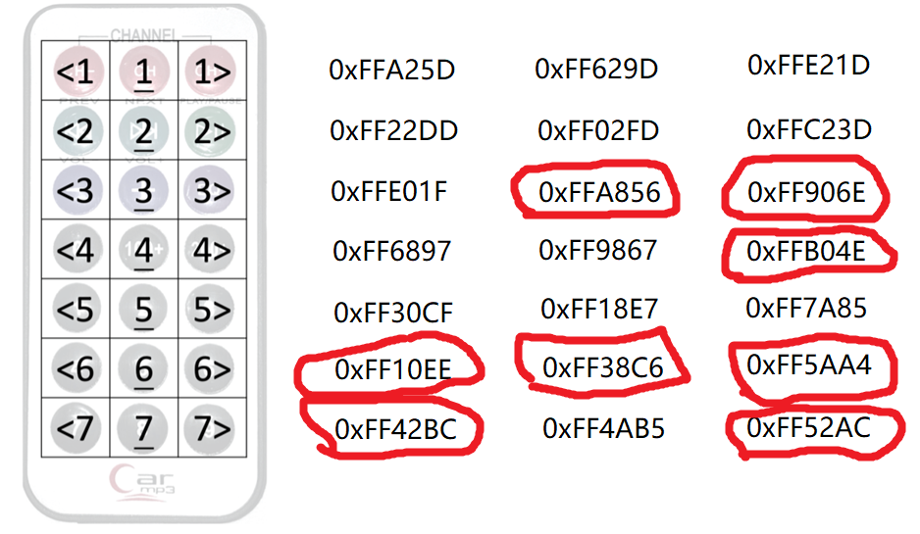
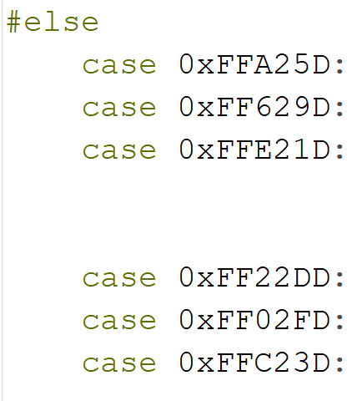
Tips for Assembling
5. Infrared Remote Control
1. The remote control is used to test the movement of the cat. But there is no response when pressing some of the buttons.
2. Because the values of some buttons in the program are slightly different from the remote control. Therefore, check the values and fill in the correct ones.
Edit in file Nybble.ino:

Slide 8
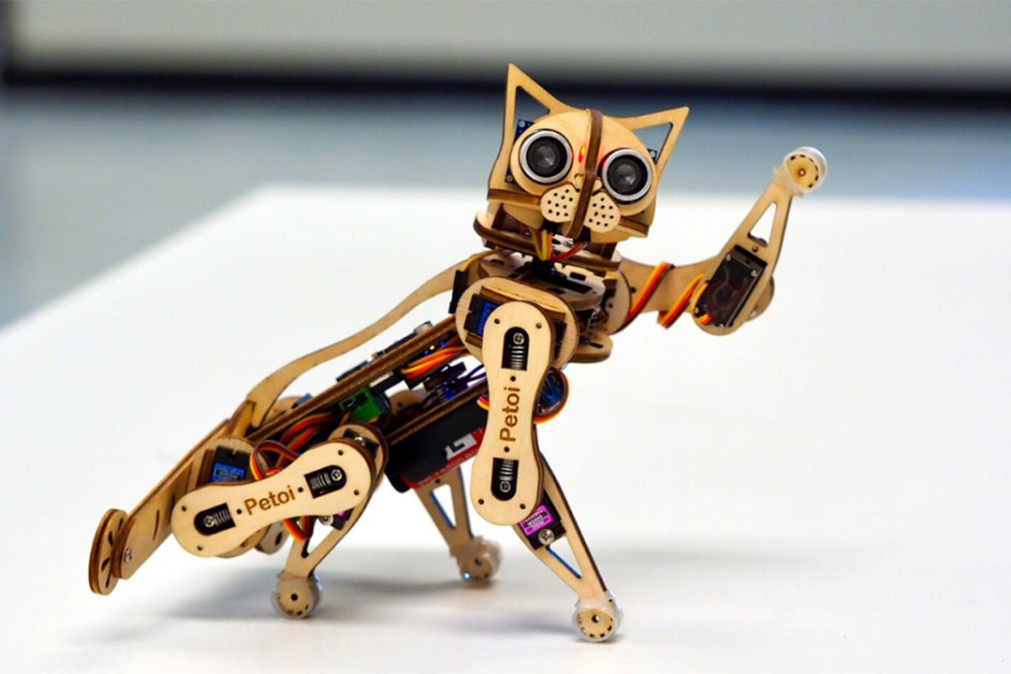
Tips for Assembling
6. Miscellaneous
1. The positive and negative electrodes of the board must be connected correctly to power on, otherwise the components on the board may be burned out! ! !
2. Update your instincts during the first calibration procedure! ! !
3. The button cell of the remote control is not included. Ask the manufacturer for it or buy it yourself.

Slide 9
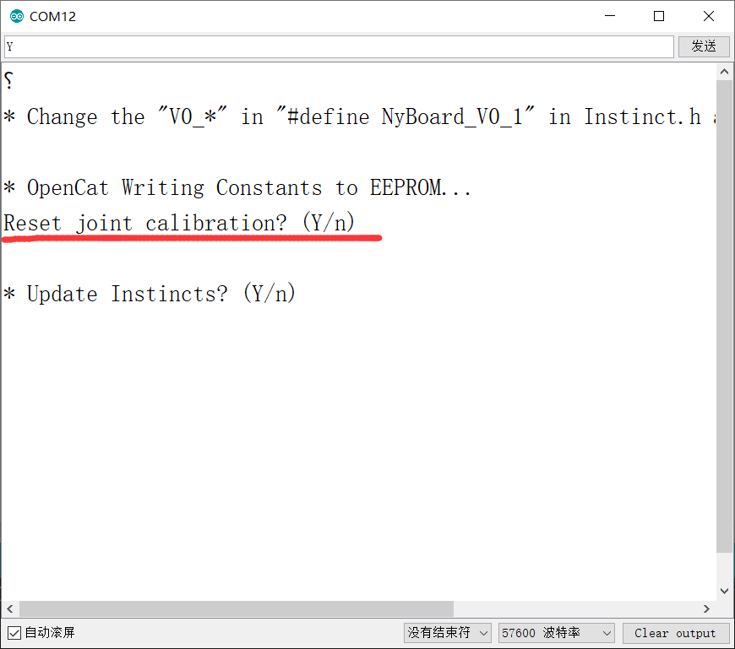
Tips for Assembling
If we pick “Y”, the joint calibration data will be reset to default. When we calibrate the joint, we must select “n” every time we encounter this problem. Otherwise we will have to recalibrate after resetting.
Miscellaneous
4. (a) When installing for the first time, do Not tighten the joint screws. Because the steering angle must be calibrated.
(b) It will show a prompt when opening the serial port:

Slide 10
Tips for Assembling
Miscellaneous
4. The second question is whether to update the instinct. It needs to be updated when it’s powered on for the first time.
Updating is only needed when new instincts are designed.

Slide 11

THANK YOU
林天麟 教授
香港中文大学（深圳）
机器人与人工智能实验室
WeChat: tinlunlam

